Slide 1
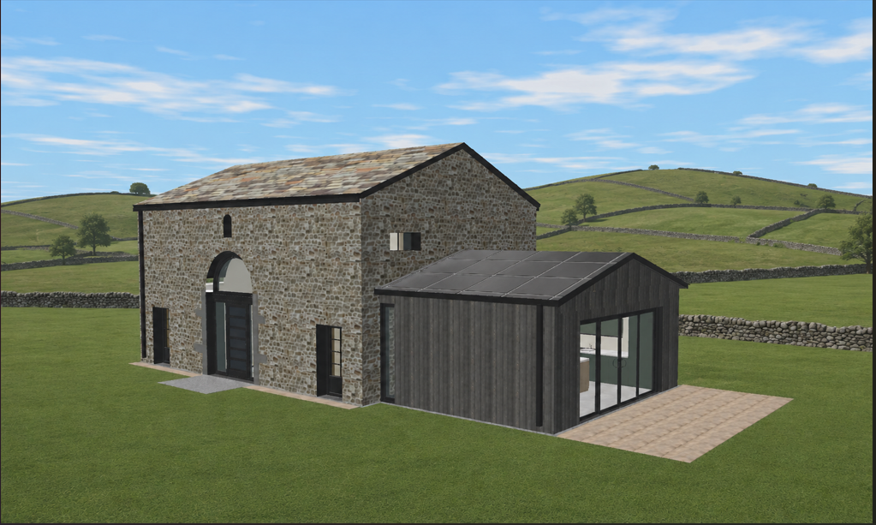
STID FOLD BARN 2026 (AI IMAGE)

Slide 2
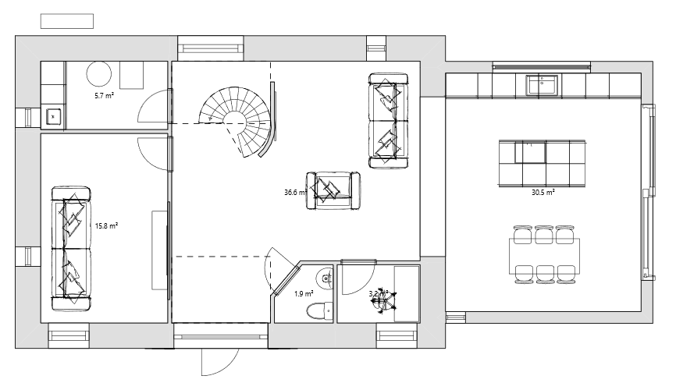
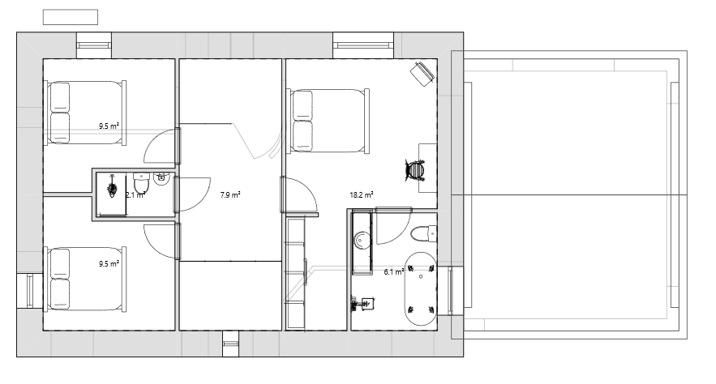
Air Source
Heat Pump
Hot Water Cylinder & UFH Manifolds
STID FOLD BARN 2026
Utility
Kitchen
Living
Snug
Toilet
Office
Dining
Bed 2
Master Bed
Bath
Bed 1
En-suite

Slide 3
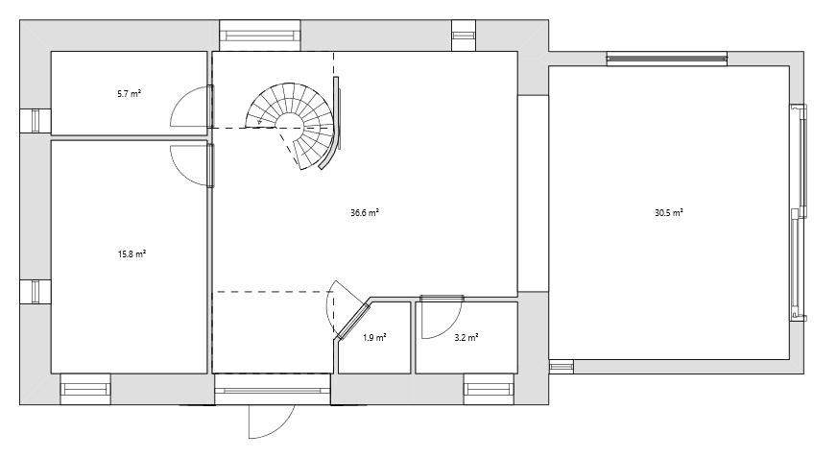
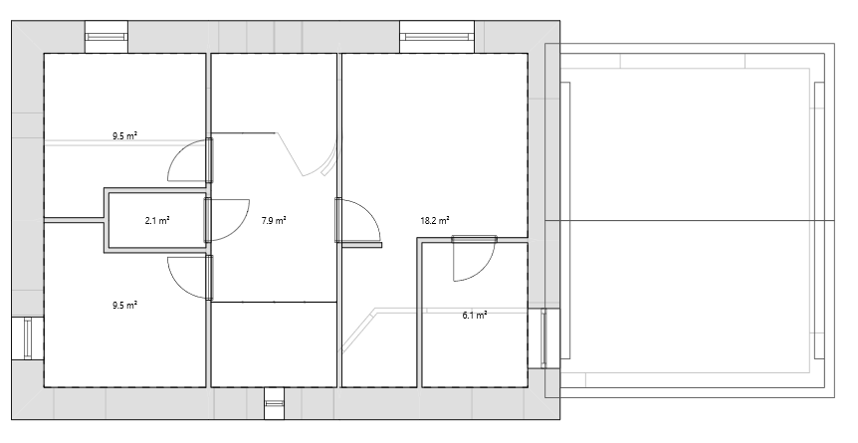
STID FOLD BARN 2026
1750mm
5100mm
6400mm
3250mm
5100mm
1500mm
5000mm
2530mm
1500mm
2120mm
3720mm
2700mm
3700mm
1200mm
1100mm
1950mm
3400mm
2120mm
2700mm
2900mm
1500mm

Slide 4
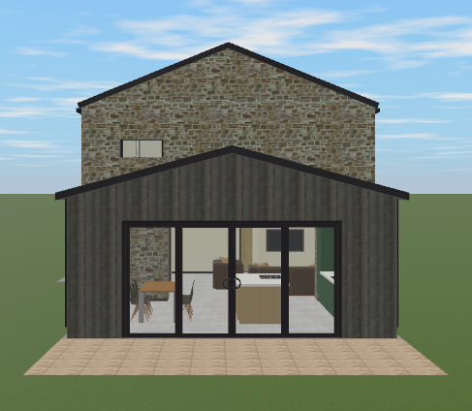
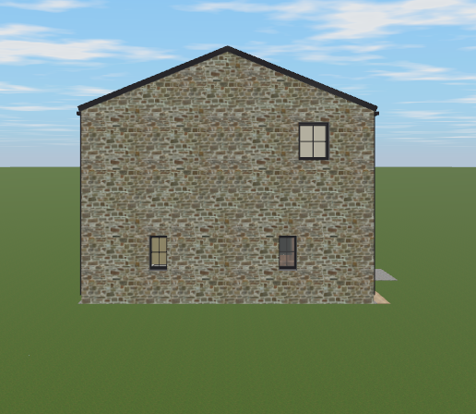
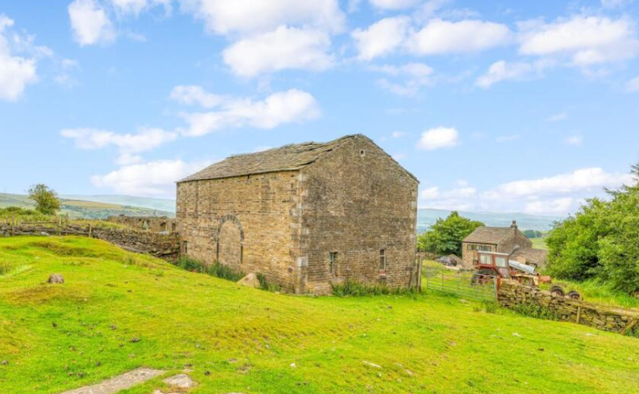
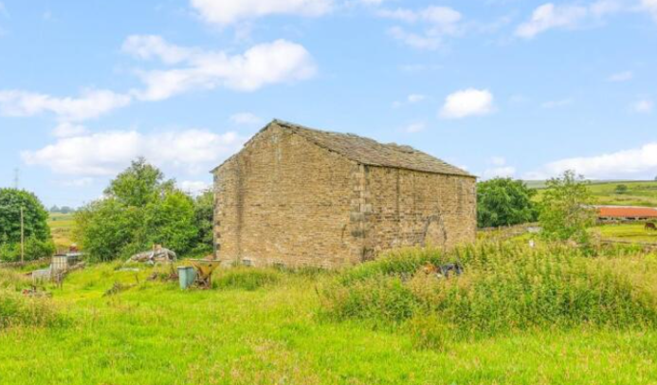
STID FOLD BARN 2026 – SIDE ELEVATIONS
Dimensions on next page

Slide 5
STID FOLD BARN 2026 – SIDE ELEVATIONS
1450mm
(to underside)
937mm
(to underside)
5430mm
(to underside of eaves)
2600mm
(to underside of eaves)
2400mm
4500mm

Slide 6
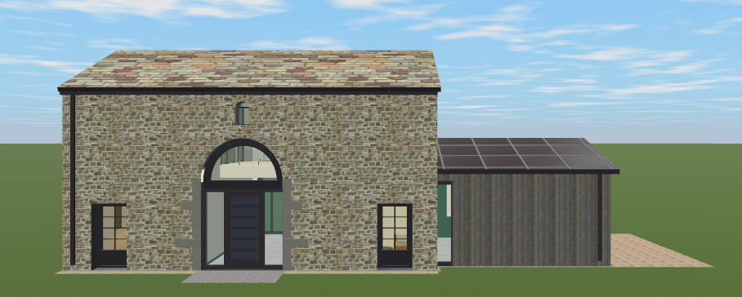
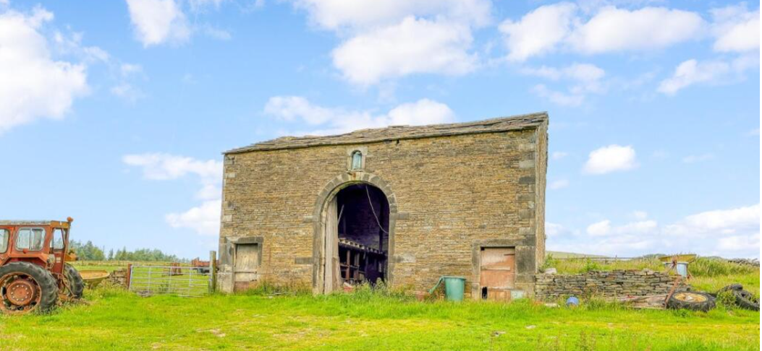
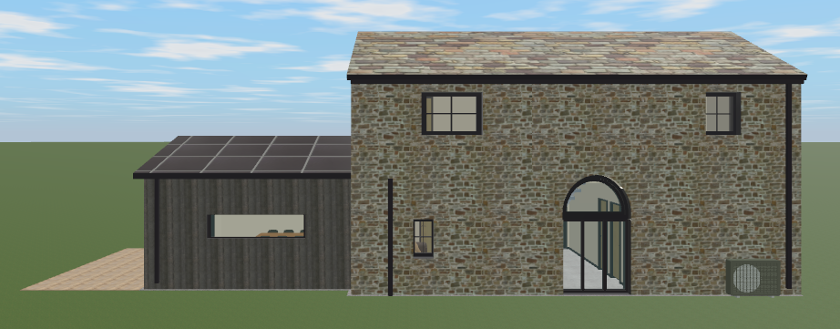
STID FOLD BARN 2026
FRONT & REAR ELEVATIONS

Slide 7
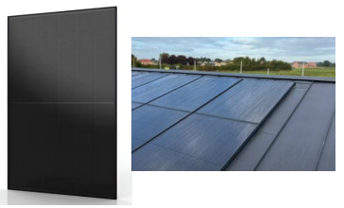
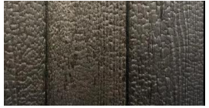
STID FOLD BARN 2026 (MATERIALS)
Black integrated solar panels on roof surrounded by black stand and seam metal roofing
Charred Timber Cladding

Slide 8
STID FOLD BARN 2026 (MATERIALS)
Black metal cast aluminium guttering and downspouts

Slide 9
STID FOLD BARN 2026 (MATERIALS)
Black metal cast aluminium guttering and downspouts

Slide 10
STID FOLD BARN 2026 (MATERIALS)
Black metal cast aluminium soil pipe

Slide 11
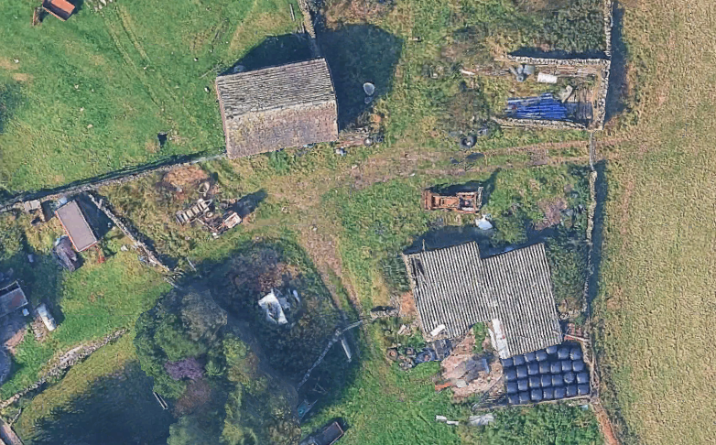
Barn & Extension location and footprint
Existing Ruin
Identified Parking for 2x cars to SPD guidelines of 3.6m x 4.8m for each vehicle
Patio area (this forms part of suitable garden space alongside section between patio and ruin for sitting, drying clothes, children playing as per SPD guidelines)
STID FOLD BARN PLOT

Slide 12
Temporary Caravan – onsite living and amenities – lands on existing hard standing
Existing Ruin
Temporary Storage Containers and site amenities
STID FOLD BARN PLOT

